Slide 1
Twitter Sentiment Analysis for US Airlines
Springboard Capstone 3
By: Vinh Mai

Slide 2
Outline:
Problem Statement
Stakeholders
Background
Data & Method – The Data, Cleaning, EDA
Model – Naïve Bayes, KNN, SVM, Random Forest, Gradient Boost, Metrics
Conclusion – Call-to-Action, Improvements
Credits

Slide 3
Problem Statement
Airline Data Inc. requires the classification of 14,640 airline-related tweets into positive, negative, or neutral categories with an 80% f1-score within four weeks. The aim is to improve customer experience and brand reputation by analyzing sentiment and providing actionable insights. The solution space involves collecting, pre-processing, and analyzing data with constraints on data availability, time, budget, model complexity, privacy, and technical considerations.

Slide 4





StakeHolders
Albert Wilkins
Anita Kane
CCO
Director of Marketing
Elisabeth Porter
Junior Sullivan
Head of Operations
Data Protection Officer
Richard Danson
Head of IT
*Not real people

Slide 5
Background
Customer Sentiment of US Airlines

Slide 6
Business opportunities are like buses. There's always another one coming.
“
”
Richard Branson

Slide 7
Background
Twitter is a widely used platform for customers to express their opinions and experiences with airlines. To analyze these tweets, sentiment analysis can be utilized to categorize them into positive, negative, or neutral sentiment categories. This type of analysis involves utilizing natural language processing techniques and machine learning algorithms to extract meaning from the text data and classify it into different sentiment categories. Researchers and industry professionals have utilized Twitter sentiment analysis to gain insights into customer opinions and feelings about different aspects of the airline industry. This technique can be particularly useful in identifying common customer complaints, determining areas for improvement, and monitoring brand reputation. Overall, Twitter sentiment analysis provides an efficient and insightful method for understanding the customers' sentiments towards the airline industry.

Slide 8
Data & Method
Using machine learning to preprocessing text data, evaluating models performance using precision, recall, and F1-score, and comparing their overall weighted scores to determine the best performing model in predicting the sentiment of 14640 tweets of US airlines.

Slide 9
Data & Method
Data.World: Crowdflower https://data.world/crowdflower/airline-twitter-sentiment
Method
This data contained: 'Airline-Sentiment-2-w-AA.csv’
14640 rows of data with 19 columns.
Columns:
Preprocessed data: cleaning, removing stop words, and converting to numerical form.
Split preprocessed data into train and test sets for classification.
Utilized five classification models: Naive Bayes, K-NN, SVM, RF, and GBC.
Trained each model on the train set and predicted sentiment on the test set.
Assessed model performance with precision, recall, and F1-score.
Visualized evaluation results with Seaborn for nuanced insights.
Identified biases/limitations in the models during analysis.
Compared models' overall performance and selected the best one using a bar plot.
_unit_id
_golden
_unit_state
_trusted_judgments
_last_judgment_at
airline_sentiment
airline_sentiment:confidence
Negativereason
negativereason:confidence
Airline
airline_sentiment_gold
Name
negativereason_gold
retweet_count
Text
tweet_coord
tweet_created
tweet_id
tweet_location
user_timezone.

Slide 10
Data & Method
Cleaning
EDA
Original DataFrame had irrelevant data
The DataFrame was summarized into two columns: the tweet text and the labeled sentiment.
NLP techniques used: regular expressions, emoji handling, and tokenization.
'preprocess_text_data()' function: replaced usernames, numbers, and emojis with text description and tokenized text.
Matplotlib and Seaborn visualization: countplot and stacked bar chart.
Scikit-learn's preprocessing module: label encoding on categorical variables.
Label encoding turns categorical variables into numerical format for machine learning models.
It's useful for unordered categorical variables.
Encoded numerical values can be used as input features in machine learning models.

Slide 11
Model
The data was preprocessed and converted to numerical form using CountVectorizer, and used to train and compare the performance of various classification models.

Slide 12
Model
Training
Models Compared
Hyperparameter Tuning
train_test_split: 70% train data, 30% test data.
'CountVectorizer’: convert text data into numerical feature vectors.
NLP models only operate with numerical inputs.
Classifiers:
Naïve Bayes
Support Vector Machines
K-Nearest Neighbors
Random Forest Classifiers
Gradient Boosting Classifiers
Precision, recall, F1-score used to compare models.
Overall, SVM performed the best with average precision (0.78), recall (0.78) and F1-score (0.77).
SMV model was tuned to increase performance
The best Hyperparameters were {'C': 0.1, 'gamma': 'scale', 'kernel': 'linear’}.
This increased performance of the model: F1-score = 0.80

Slide 13
Classification Report
Naïve Bayes
Precision: 0.76
K-Nearest Neighbors
Precision: 0.65
Support Vector Machine
Precision: 0.78
Precision: 0.75
Gradient Boost
Random Forest
Recall: 0.76
F1-score: 0.74
Recall: 0.49
F1-score: 0.52
Recall: 0.75
F1-score: 0.72
Precision: 0.73
Recall: 0.74
F1-score: 0.70
Recall: 0.78
F1-score: 0.77
1
2
3
4
5

Slide 14
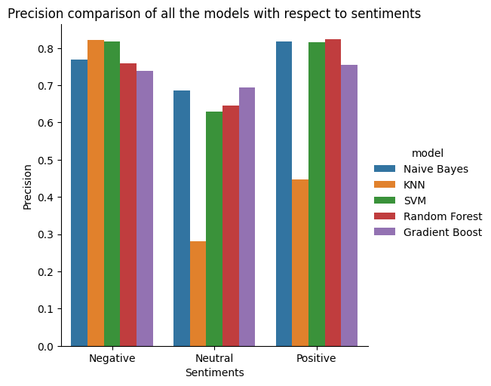
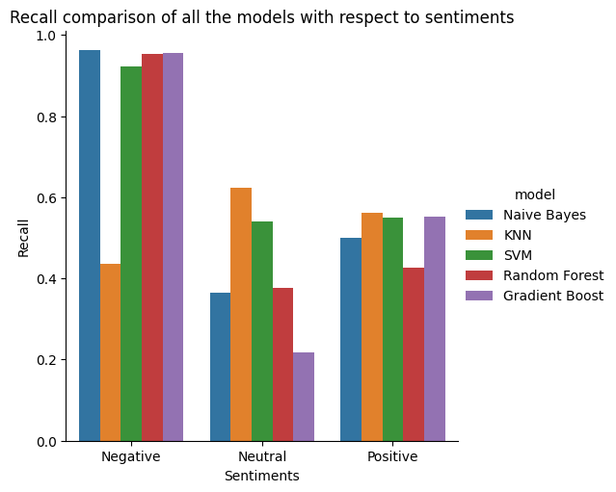
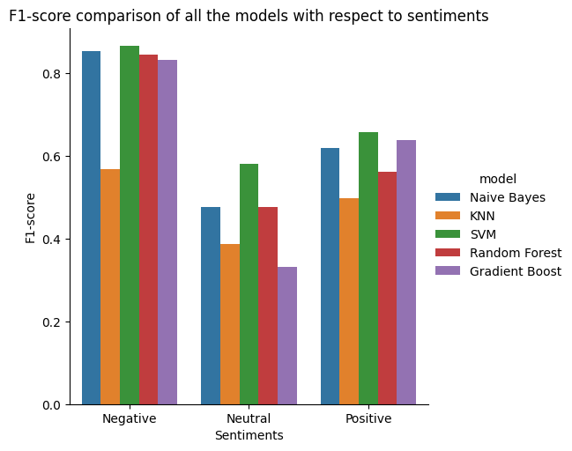
Model Comparisons

Slide 15
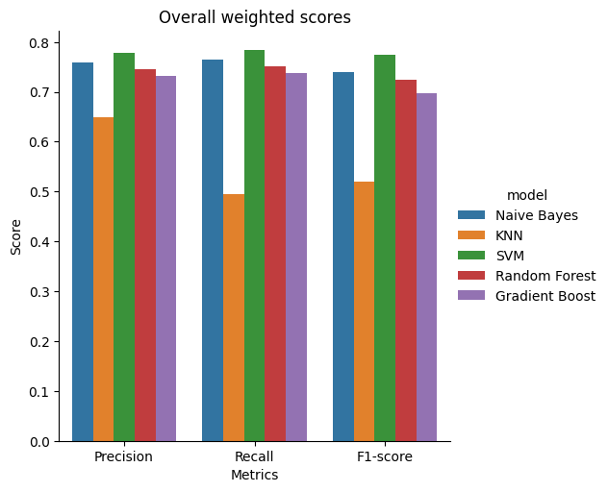
Overall Weighted Scores

Slide 16
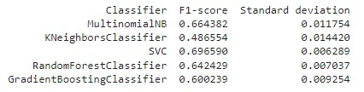
5-fold Cross-validation
Cross-validation confirmed the outcome of the model comparisons prior.
SVM performed best with F1-score of 0.70.
Other models performed almost as well.

Slide 17
Conclusion
The sentiment classification task was effectively completed by all models, but SVM demonstrated the best performance in terms of 'Overall Weighted Scores'. Random Forest and SVM demonstrated better precision and F1-scores than other classifiers, while Naive Bayes had the highest recall score, albeit marginally. Cross-validation using Scikit-learn's 'cross_val_score' with F1-score as the metric of interest was performed to confirm the results of the prior comparison, and SVM was indeed the best-performing model for the data input. The SVM model was further refined by Hyperparameter Tuning, and the best hyperparameters were identified as {'C': 0.1, 'gamma': 'scale', 'kernel': 'linear'}. This modification resulted in an F1-score of 0.80. Using this model, Airline Data Inc. could correctly categorize the tweets about US airlines up to 80% accuracy, taking into account both false positives and false negatives.

Slide 18
Thank you
Crowdflower: https://data.world/crowdflower/airline-twitter-sentiment
Rai, Sawan: https://www.analyticsvidhya.com/blog/2021/11/an-empirical-study-of-machine-learning-classifier-with-tweet-sentiment-classification/

